Slide 1

Major Project On
Hardware based Intrusion Detection System
-- Amit Sharma
-- Atif Ahmed Khan
-- Nishant Kumar

Slide 2
Intrusion Detection System
An intrusion detection system (IDS) is a device or application that monitors all inbound and outbound network activity.
It identifies suspicious patterns that may indicate a network or system attack from someone attempting to compromise the system.
In other words it is an intelligent system which is deployed on the physical layer in a network which then monitors any unauthorized intervention to the environment.

Slide 3

IDS
Monitors:
network
systems
To look for:
malicious activity
policy violations
Types:
HIDS(Host bases IDS)
NIDS(Network based IDS)

Slide 4
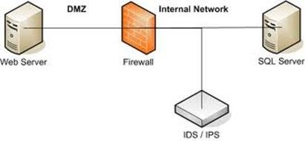
Comparison with firewall
Firewall looks for intrusions and stops them.
IDS evaluates a intrusion and alarms the user.
Firewall is usually helpless against tunneling atttacks.
Firewall cannot detect security breaches associated with traffic that doesn’t pass through it.

Slide 5
Approaches for Intrusion Detection
Statistical anomaly threshold detection
In this approach the data is collected relating to the behavior of a legitimate user. A profile of activity is created of each user and is then developed for further use to detect any significant behavior that would lead to a suspicious act.
Rule based anomaly detection
This detection method defines the set of rules that can be used to define the type of behavior of an intruder. These rules may represent past behavior patterns (of users, devices, timelines, etc.) which are matched to the current patterns to determine any intrusion.

Slide 6

Tools Used
Snort
Open source tool created by Martin Roech.
It is Used to detect Intrusion.
It is an NIDS which captures & scans real-time network traffic .
It then examines each packet closely to detect intrusion.

Slide 7
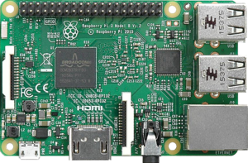
Raspberry Pi
It is a low cost, credit-card sized computer that plugs into
a monitor or TV, and uses a standard keyboard and mouse.
It can simply turn into a powerful Honeypot or attack detector.
Using a Raspberry Pi in a network makes the network administrators work less complex and easy to implement.

Slide 8
Other Recruitments
To make our security system we need:
An SD card(Preferably an 8GB class 6 card).
An Ethernet cable .
A micro-usb power cable .
A Minibian OS image.
Win32DiskManager software.
An USB keyboard (during the time of installation)

Slide 9
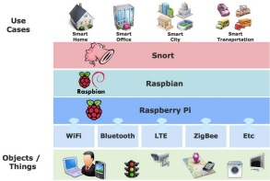
Architecture

Slide 10
Why This Project

